Slide 1

Data Engineering
Final Project
Swati Susan Sathyan

Slide 2
Executive Summary
The project provides an overview of the food inspection results for Chicago for a period ranging from 2010 to present
Details
The tableau dashboard provides the following analysis
Trend in violation from 2010 to present day.
Breakdown based on inspection type
Breakdown based on Risk type
Overview of the facility type with the most violations
The total count of business and the breakdown by License status
Easy lookup of the application type based on business type
Easy lookup of the License code based on description.
Historical Details of Business – Inspection and License

Slide 3

Research objective
The objective of this project is to provide business and future business owners a better understanding of the business licenses and the food inspection details in the city of Chicago.
Identify patterns in violation using the food inspection data set
The data sets used for this project are
Chicago food inspection
Business Licenses

Slide 4
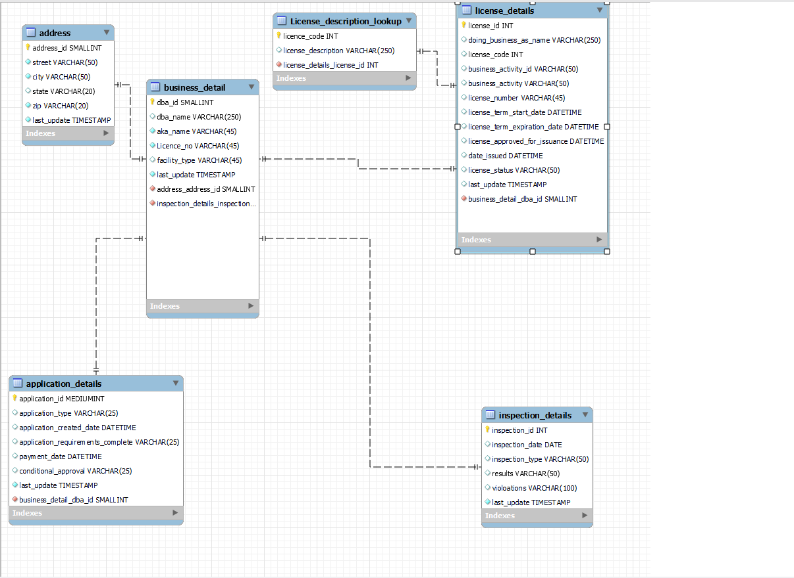
EER Diagram

Slide 5

Data analysis and Visualization

Slide 6
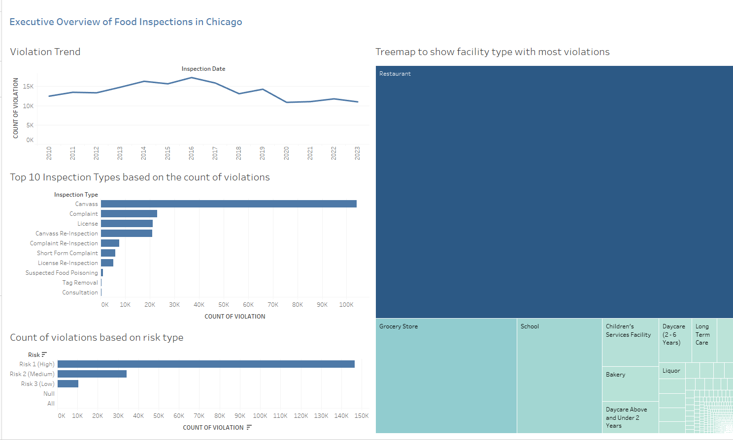

Slide 7
